Slide 1
Stacks

Slide 2
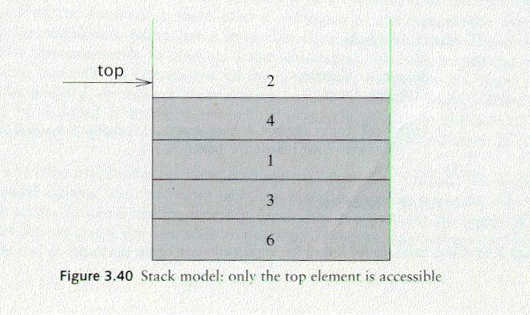
Stack Overview
Stack: A Stack is a list of elements in which an element may be inserted or deleted only at one end called the top of the stack Lists( LIFO (Last In, First Out) )
Basic operations of stack
  “Push” is the term used to insert an element into a stack.
  “Pop” is the term used to delete an element from stack. etc.
empty stack
push an element
push another
pop
top
B
top
top
top
A
A
A

Slide 3
Implementations of stacks
Any list implementation could be used to implement a stack
  Arrays (static: the size of stack is given initially)
  Linked lists (dynamic: never become full)
Array Representation:
1 | 2 | 3 | 4 | 5 | 6 | 7 | 8
XXX | YYY | ZZZ | AAA | BBB
TOP
MAXSTK

Slide 4
Array Implementation
Need to declare an array size ahead of time
Associated with each stack is TopOfStack
  for an empty stack, set TopOfStack to -1
Push
  (1) Increment TopOfStack by 1.
  (2) Set Stack[TopOfStack] = X
Pop
  (1) Set return value to Stack[TopOfStack]
  (2) Decrement TopOfStack by 1
These operations are performed in very fast constant time

Slide 5
PUSH(STACK, Top, MaxStk, Item)
  [Stack already filled]
  if TOP=MAXSTK then print: overflow and return
  2) Set TOP=TOP+1 [Increases top by 1]
  3) Stack[TOP]=Item.
  4) Return.
POP( Stack, Top, Item)
  [Stack Empty]
  if TOP=0 then print: Under flow and return
  2) ) Item =. Stack[TOP] [Assign top element to item]
  3) Set TOP=TOP-1 [Decreases top by 1]
  4) Return.

Slide 6
Application of Stacks:
  Evaluating postfix expressions
  Quick Sort.
  Converting Infix to postfix expression
  Tower of Hanoi problem
  Factorial of a number
  Fibonacci series

Slide 7
Arithmetic Expression; Polish Notation
Polish Notation:
For most common arithmetic operations, the operator symbol is placed between its two operands: Example: A+B,C-D
This is called infix Notation. With this notation, we must distinguish between (A+B)* C and A + (B*C). By using parantheses or some operator-precedence convention.
Polish Notation: Refers to the notation in Which the operator symbol is placed before its two operands example: +AB,-CD
Translate the given infix notation into polish notation: Bracket[] indicate partial
(A+B)*C=[+AB]*C = *+ABC , A+(B*C)=A+[*BC]=+A*BC
(The Fundamental property of polish notation is that the order in which the operations are to be performed is completely determined by position of the operators and operands in the expression, one never need parenthesis when writing expression in polish notation)

Slide 8
In Reverse polish notation the operator symbol is placed after its two operands.Example: AB+ , CD-( one never needs a parenthesis to determine the order of the operations in any arithmetic expression)

Slide 9
Evaluation of postfix expression:- This algo
finds the value of arithmetic expression P written in postfix expression
Add a right parenthesis “) ” at the end of P.
Scan P from left to right and repeat steps 3 and 4 for each element of
P until “)” is encountered.
3. If an operand is encountered, put it on stack.
4. If an operator © is encountered, then
(a) Remove the top two elements from the stack, where A is the top
element and B is the next to top element
(b) Evaluate B © A
(c) Place the result of (b) back on the stack.
[END IF]
[END WHILE]
5. Set VALUE equal to the top element of stack.
6. Exit

Slide 10
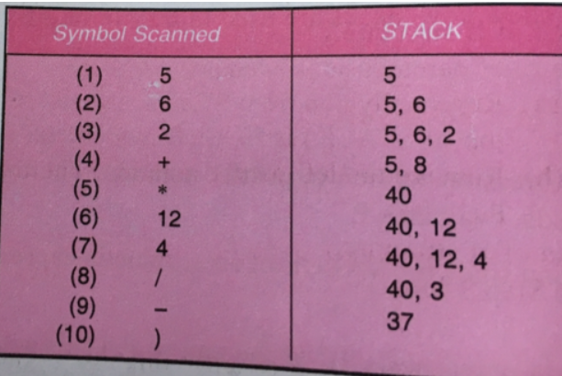
Infix: 5*(6+2)-12/4
P: 5,6,2,+,*,12,4,/,-

Slide 11
Transforming INFIX NOTATION in to POSTFIX NOTATION Algo: POLISH(Q,P) Suppose Q is an arithmetic expression written in infix notation. This algorithm finds the Equivalent Postfix expression:
      Push “(“ on to the STACK, and add “)” to end of the Q
      Scan Q from Left to Right and Repeat Steps 3 to 6 for Each Element of Q until the Stack is empty.
      If an operand is encountered, add to P.
      If a left parenthesis is encountered, PUSH it on to STACK
      If an operator © is encountered, then:
        Repeatedly POP from Stack and Add to P each operator( on the top of the stack) which has the same precedence as or higher precedence than ©
        ADD © to stack.
      If a right parenthesis is encountered, then:
        Repeatedly POP from Stack and Add to P each operator until a left parenthesis is encountered.
        Remove the left parenthesis [ Do not add to P].
      EXIT

Slide 12
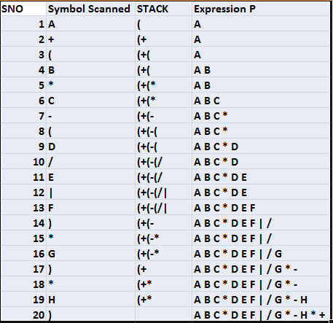
A+(B*C-(D/E|F)*G)*H

Slide 13
Practice
1.((A+B)*D) Ȋ (E-F)
2. (A-B)*(D/E)
3. (A+B Ȋ D)/(E-F)+G
4. A*(B+D)/E-F*(G+H/K)
5. (A-B)*(D/E)
6. (A+B Ȋ D)/(E-F)+G

Slide 14
Evaluation of postfix Notation
Add A right parenthesis “)” at the end of P.
SCAN P from Left to Right and repeat steps 3 and 4 for each element of P until the “)” is encounterd
If an operand is encountered put it on stack
If an operator © is encountered then
  Remove the two top elements of stack, where A is the top element and B is the next top element.
  Evaluate B © A
  Place the result of 2 back on Stack.
Set value Equal to top element on Stack
Exit

Slide 15
EXAMPLE=
Q: 5*(6+2)-12/4
Postfix :5 6 2 + * 12 4 / -
Symbol Scanned | STACK
5 | 5
6 | 5,6
2 | 5,6,2
+ | 5,8
* | 40
12 | 40,12
4 | 40,12,4
/ | 40,3
- | 37
)

Slide 16
Quicksort

Slide 17
Quicksort I: Basic idea
Pick some number p from the array
Move all numbers less than p to the beginning of the array
Move all numbers greater than (or equal to) p to the end of the array
Quicksort the numbers less than p
Quicksort the numbers greater than or equal to p
p
numbers less than p
p
numbers greater than or equal to p

Slide 18
Quicksort II
To sort a[left...right]:
1. if left < right:
  1.1. Partition a[left...right] such that:
  all a[left...p-1] are less than a[p], and
  all a[p+1...right] are >= a[p]
  1.2. Quicksort a[left...p-1]
  1.3. Quicksort a[p+1...right]
2. Terminate

Slide 19
Partitioning (Quicksort II)
A key step in the Quicksort algorithm is partitioning the array
  We choose some (any) number p in the array to use as a pivot
  We partition the array into three parts:
p
numbers less than p
p
numbers greater than or equal to p

Slide 20
Partitioning II
Choose an array value (say, the first) to use as the pivot
Starting from the left end, find the first element that is greater than or equal to the pivot
Searching backward from the right end, find the first element that is less than the pivot
Interchange (swap) these two elements
Repeat, searching from where we left off, until done

Slide 21
Partitioning
To partition a[left...right]:
1. Set pivot = a[left], l = left + 1, r = right;
2. while l < r, do
  2.1. while l < right & a[l] < pivot , set l = l + 1
  2.2. while r > left & a[r] >= pivot , set r = r - 1
  2.3. if l < r, swap a[l] and a[r]
3. Set a[left] = a[r], a[r] = pivot
4. Terminate

Slide 22
Example of partitioning
choose pivot: 4 3 6 9 2 4 3 1 2 1 8 9 3 5 6
search: 4 3 6 9 2 4 3 1 2 1 8 9 3 5 6
swap: 4 3 3 9 2 4 3 1 2 1 8 9 6 5 6
search: 4 3 3 9 2 4 3 1 2 1 8 9 6 5 6
swap: 4 3 3 1 2 4 3 1 2 9 8 9 6 5 6
search: 4 3 3 1 2 4 3 1 2 9 8 9 6 5 6
swap: 4 3 3 1 2 2 3 1 4 9 8 9 6 5 6
search: 4 3 3 1 2 2 3 1 4 9 8 9 6 5 6 (left > right)
swap with pivot: 1 3 3 1 2 2 3 4 4 9 8 9 6 5 6

Slide 23
Partitioning at various levels

Slide 24
Recursion:
Suppose P is a procedure containing either a call statement to itself or a call statement to a second procedure that may eventually result in a call statement back to the original procedure P then P is called a Recursive Procedure. A program will not continue to run indefinitely a recursive procedure must have the following two properties:
There must be certain criteria, called base criteria for which the procedure does not call itself.
Each time the procedure does call itself, it must be closer to the base Criteria.
A recursive procedure with these two properties is said to be well defined.
Example:
Tower of Hanoi:

Slide 25
Rules
1. Only one disk may be moved at a time. Specifically, only the top disk on any peg may be moved to any other peg.
2. At no time can a larger disk be placed on a smaller disk
Move the top N-1 disks from peg A to Peg B.
Move the top disk from PEG A to Peg C, A -> C
Move the top n-1 disks from peg B to C
Sol:
Tower(N-1,Beg,End,Aux)
Tower(1,Beg,Aux,End)
Tower(N-1,Aux,Beg,End)

Slide 26
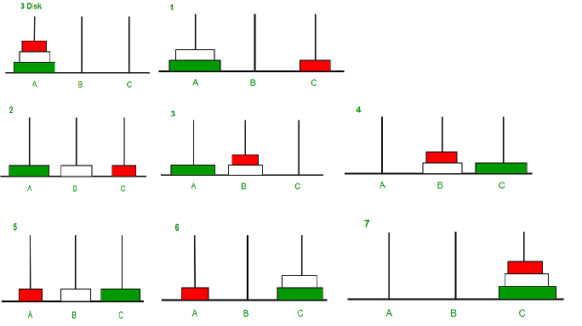


Slide 27
Tower (N, Beg, Aux, End)
1 If N=1 then
a) Write Beg -> End
b) Return
2 Call Tower(N-1,Beg,End,Aux)
3 Write Beg -> End
4 Call Tower(N-1,Aux,Beg,End)
5 Return

